Slide 1
Hyperbole
Edgar Poe vs. Shel Silverstein

Slide 2
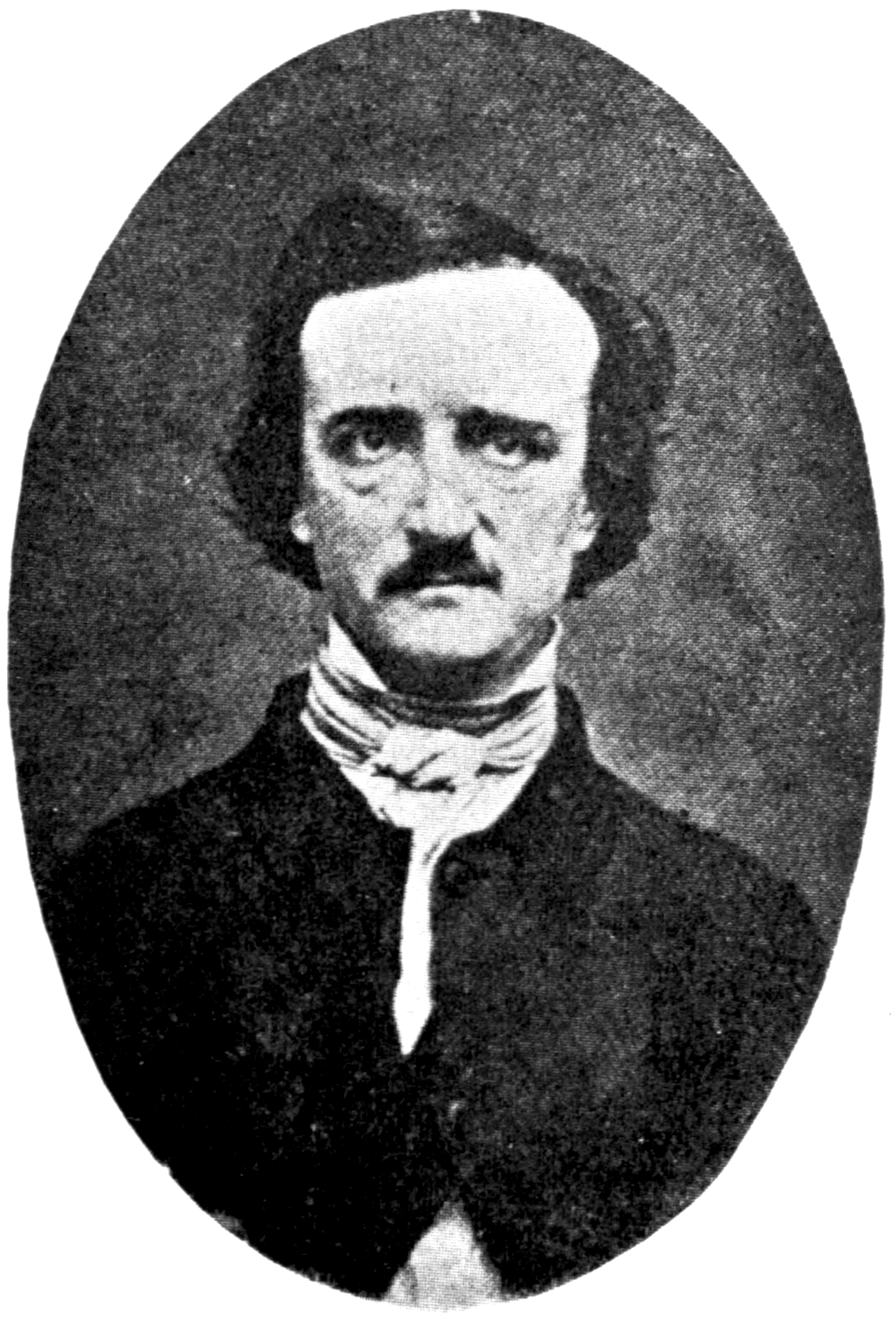
Who used it better?
Between Shel Silverstein and Edgar Allan Poe, Poe was the author who used hyperbole better.

Slide 3
Evidence
Poe used hyperbole better than Shel Silverstein. This statement is shown in many ways and context. In Poe’s stories, his hyperboles capture the reader’s attention more fully than Shel Silverstein does. Poe’s hyperboles also give a better understanding to the context, but Shel merely used them for comical reasons.
For the moon never beams without bringing me dreams
Of the beautiful Annabel Lee;
And the stars never rise but I feel the bright eyes
Of the beautiful Annabel Lee;
- Annabel Lee by Edgar Allan Poe
In this poem, the moon can rise without bringing him dreams and the stars will rise. Poe does not literally mean that these things will happen; he means to show his loss because of Annabel Lee

Slide 4
Comparison
In comparison to Poe, Silverstein’s hyperbole uses were usually to give an item a new view. Poe used many hyperboles to not only express a new image to an item, but also to people and feelings. This was one of the reasons that his connected and left such an impact on his readers. It was because they now had an idea of how to relate his poems and stories.

